Slide 1
Comparing Television Regulations in the
U.S. and North Korea
Alessia Catania, Alison Clark, Jack Raynor,
Kate Rydland, Ian Ki Hoon Suh, Lauren DeMunno
Notes:
Alessia

Slide 2
Why did we choose television in North Korea?
Often seen as a very censored country
Provides a good dichotomy of cultures when compared to the U.S.
Controversy over North Korean media censorship involving human rights
Stereotypes emerge
  North Koreans may be less informed/open-minded than Americans because of restricted foreign media
Notes:
Alessia
Out of McKenzie’s 9 elements of a media system, we chose to focus on media regulation (specifically television), and how it differs in the U.S. and North Korea

Slide 3
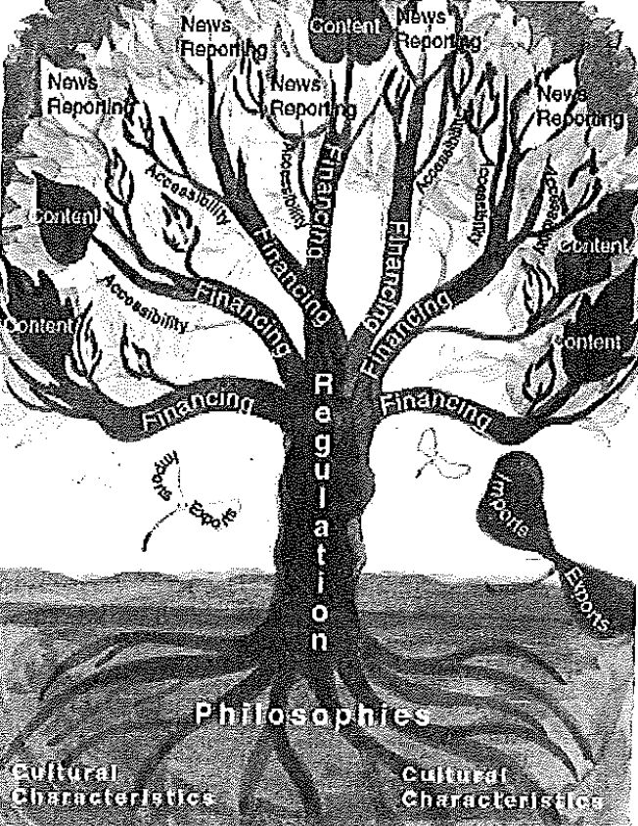
What is a Media System?
An interaction between different media organizations and operations to develop and equip each other.
Media coming together to deliver better content
Establishing sound context for public consumption
Ensuring all media content is focused on economically, socially and economically healthy practices.
Notes:
A media system is an establishment formed by different media firms and an incorporation of their different operations in order for them to equip and develop each other for better functioning. The importance of this system is that the media firms regulate themselves other than being dependent on the government policies. There are two approaches of media systems . One is a normative-critical approach which focuses on generalization of media content. The second is the new analytical approach which tries to explain the transformation of media and its impact to its audience and the environment economically, political and socially.
Reference
Mancini, P. (2019). Media Systems and Journalism. In Oxford Research Encyclopedia of Communication.
ian: Alessia, do you just want me to do slide 4?

Slide 4
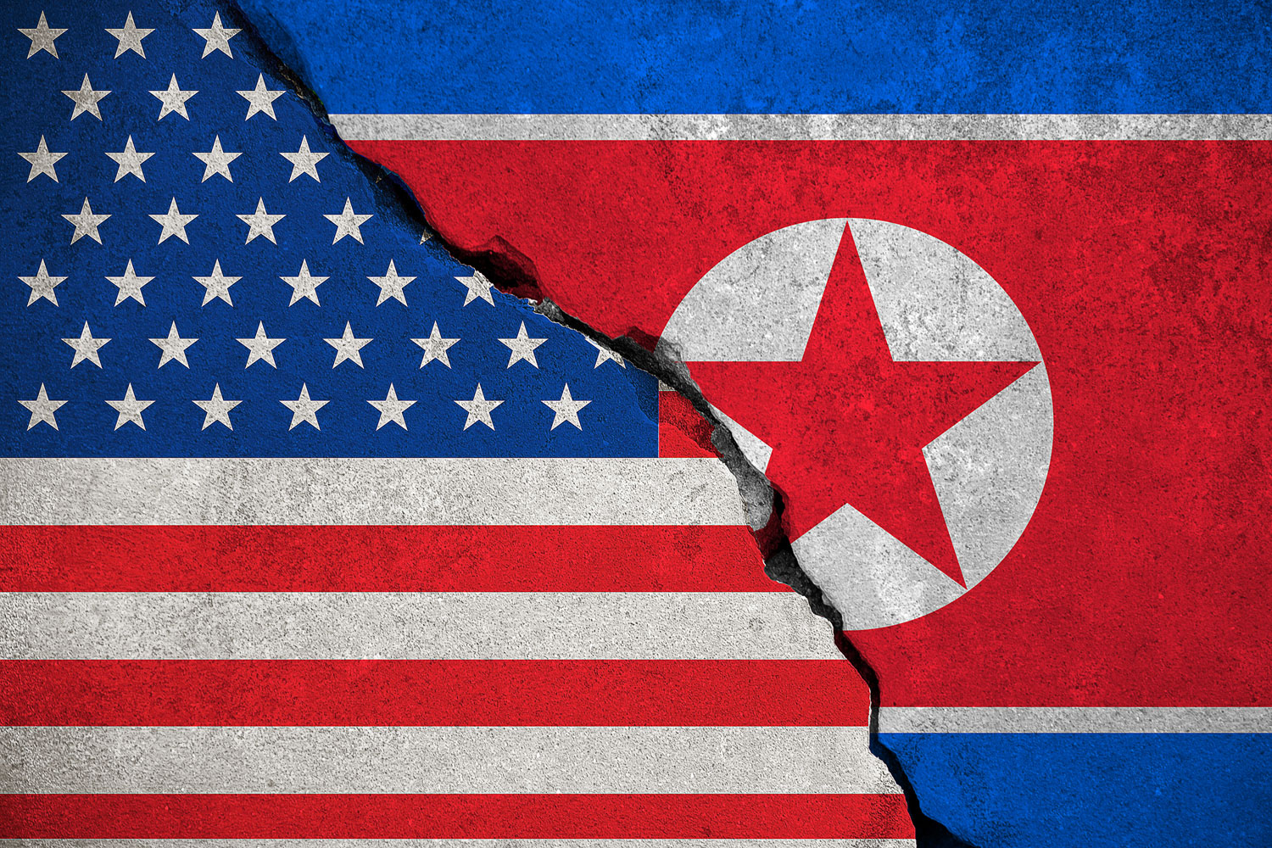
Comparing Media Systems in Korea and U.S.
Similarities:
Differences:
both country have Television, Radio, newspaper, and magazines
Literally levels are above 99% hence public advocate for free media
The internet is advanced in both countries.
Government oversees the operations of the rnedia in their countries.
No independent Media (intervene by government ) in Korea, the U.S. has both private and public broadcasters.
North Korea do not have well activated web-media system while the U.S. is well structured by the FCC.
Not democratic for Korea but very democratic for the U.S.
Licensing renewal for radio and TV in U.S. after 8years but Korea its annual.
Television sets in U.S. are not restricted but in Northern Korea it restricted to PLA system
Cell phones for foreigners are restricted to YPT network in U.S. not restrictions.
Notes:
The U.S. controls both public and private broadcasters through the FCC. FCC is a body is a body formed from the house of representative and senate. The primary influence of media and broadcasting in the U.S. is commercial marketplace of broadcasters. There is a lot of freedom in broadcasting because there are different ideologies from different walks of life that are perceived right.
Northern Korea is strict o content of media and is highly controlled. Television sets only operate through the PLA system to prevent receiving broadcasts from the South Korea, if TV’s are imported they are disabled by the government. Cell phones for foreigners are restricted to YPT network which only enables the call outside Korea and not locally, they also access internet fro satellite. The global internet is only for the high-level official.

Slide 5
Overall Regulation of U.S. and North Korean Media
United States:
  FCC = the foremost authority
    Creates, implements, and regulates media policies
    Legislative Branch provides checks and balances
North Korea:
  Very strictly controlled
  Constitution nominally provides freedom of speech / press
  Government prohibits the exercise of these rights unless praising NK
Notes:
Jack
However in the US, as the government has some arbitrary powers themselves, and the demands of the public further control the absolute powers of the government.
MAKE SURE THAT THE BELOW NOTES ARE CORRECT/ COMBINED INTO THIS SLIDE IF NEEDED
NK Differences:
Authoritarian outlook
Only 1 TV news source KCTV
No private TV presence
4 channels allowed
Channels only allowed to air at certain times
US Differences:
Libertarian outlook
Many different TV news sources
Mostly private TV presence
Hundreds of channels
Channels can air 24/7 if they want
______________________________________________________________
Doesn’t need to be exactly 3 each, just writing for spacing
Difference 1: In the United States there are alot of different TV stations while there is one major one in North Korea, KCTV.
Difference 2: When you buy a TV or get in your brand new car to listen to the radio, your not going to hear or see the news in the US. In North Korea, however all of the radio stations and TV sets are prechecked by government officials and loaded with government stations. This leads to North Koreans buying other radios illegally.
Difference 3: No TV guide: In North Korea, the TV stations only operate for a few hours daily. For example, Korean Central TV (KCTV) only transmits for seven hours a week and ends programming by 3pm, while other channels only operate for a few hours. This is because of the lack of electricity in North Korea.
we must have 3 peer reviewed sources within the pres.

Slide 6
Comparing Television Regulation
United States
Libertarian Theory
Hundreds of channels allowed
Channels allowed to operate 24/7
Mostly privately owned TV stations
North Korea:
Authoritarian Theory
Only 4 channels allowed
Channels have restricted air times
Only government-run stations
Regulation of publicly subsidized content
Governing bodies for all TV in that nation (KCBC and FCC)
Notes:
jack Could be more brief/ Doesn’t need to be exactly 3 each, just writing for spacing
Include resources
https://psu.instructure.com/courses/2025540/files?preview=105867954
we must have 3 peer reviewed sources within the pres.
Korea - radios and TVs are pre-tuned to government stations; 4 government-owned TV stations; the Korean Workers' Party owns and operates the Korean Central Broadcasting Station, and the state-run Voice of Korea operates an external broadcast service; the government prohibits listening to and jams foreign broadcasts

Slide 7
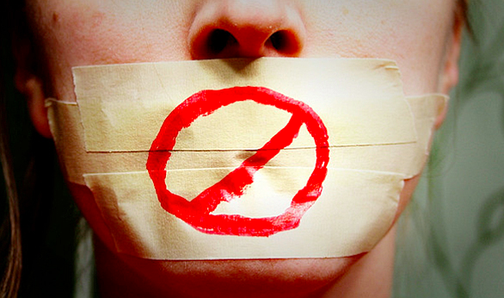
Theme #1: TV Regulation in North Korea Causes Self-Censorship
Self-censorship is especially prevalent in North Korea because all news/media is in favor of the government
Spiral of Silence Theory (Noelle-Neumann, 1974)
*Noelle-Neumann, E. (1974). The Spiral of Silence a Theory of Public Opinion. Journal of Communication, 24(2), 43–51. doi: 10.1111/j.1460-2466.1974.tb00367.x
Notes:
Alison

Slide 8
Theme #1: TV Regulation in North Korea Causes Self-Censorship
Exploring the Forms of Self-Censorship (Andrew Hayes, 2007)
Hostile opinion climate prompted more self-censorship than friendly opinion climate
North Koreans are therefore more likely to self-censor than Americans
*Hayes, A. F. (2007). Exploring the Forms of Self-Censorship: On the Spiral of Silence and the Use of Opinion Expression Avoidance Strategies. Journal of Communication, 57(4), 785–802. doi: 10.1111/j.1460-2466.2007.00368.x
Notes:
Alison

Slide 9
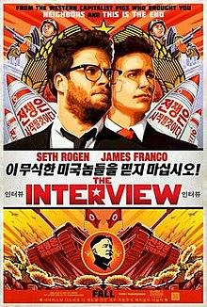
Theme #2: Use of TV as Propaganda
TV sets are preloaded with government channels
North Korea uses TV to cover up the nation’s food shortage
  Ex: The Interview
North Korea uses anti-war rallies in South as a propaganda tool
North korea TV uses anti-war rallies in south as "propaganda tools" - report. (2013, Mar 12). BBC Monitoring Asia Pacific Retrieved from http://ezaccess.libraries.psu.edu/login?url=https://search.proquest.com/docview/1315826214?accountid=13158
North korea TV carries propaganda on resolving food shortage. (2008, Aug 29). BBC Monitoring Asia Pacific Retrieved from http://ezaccess.libraries.psu.edu/login?url=https://search.proquest.com/docview/460614978?accountid=13158
Notes:
Lauren DeMunno:
Before you can even buy a TV in North Korea, the government has already preloaded them with government channels so when you turn the TV on for the first time, the first thing you see is KCTV approved channels.
One of the biggest things in North Korea is the food shortage that is going on. North Korea uses TV to make the people think they are going to resolve this crisis, when instead they are actually pushing more labor and saving more food.
If you have ever seen the popular movie, The Interview, you can see how food stores commonly put pictures of food in the windows to make it look like there is more food than there actually is in the store.
Another way North Korea uses the TV for propaganda is by taking clips from South Korea and cutting them to make it seem like South Korea is anti-America and have people believe they are anti-war.

Slide 10
Theme #3: U.S. vs. North Korea and how government can determine accessibility
**When the government determines what media is allowed, what does that mean for accessibility?
North Korea- Highly restricted, all media accessible to citizens comes directly from government
  Although accessible, only media that benefits the government
United States- Not restricted, highly accessible...depending on political party, government can be highly involved in shaming/praising certain media outlets
  Trump and his praise for Fox News, Trump and his dislike of CNN and other news outlets (Fake News)
Notes:
Kate

Slide 11
Discussion Questions
How does modern day television cultivate authoritarianism?
We talked a lot about propaganda in North Korea, but how does it manifest in the United States?
How may the North Koreans benefit from secret information distribution, similar to what we saw in the video about Cuba’s “internet”?

Slide 12
THANK YOU!
Any other questions?
Notes:
Q/A

Slide 13
References
Feintuck, M. (2006). Media regulation, public interest and the law. Edinburgh University Press.
https://freedomhouse.org/report/freedom-press/2016/north-korea
Medium Magazine, (2020). Retrieved from: https://mediummagazine.nl/media-regulation-in-the-united-states/
Hayes, A. F. (2007). Exploring the Forms of Self-Censorship: On the Spiral of Silence and the Use of Opinion Expression Avoidance Strategies. Journal of Communication, 57(4), 785–802. doi: 10.1111/j.1460-2466.2007.00368.x
Noelle-Neumann, E. (1974). The Spiral of Silence a Theory of Public Opinion. Journal of Communication, 24(2), 43–51. doi: 10.1111/j.1460-2466.1974.tb00367.x
Notes:
https://www.wsj.com/articles/u-s-targets-north-korean-censorship-with-sanctions-1544473956

